Slide 1


IPV4/IPV6 - IP Addressing Schemes
IP addressing and networking basics can be complex. In this presentation, we'll discuss IPV4 and IPV6, reserved ports, and the basics of addressing schemes using clear examples.

Slide 2

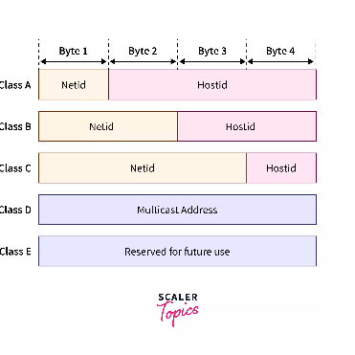
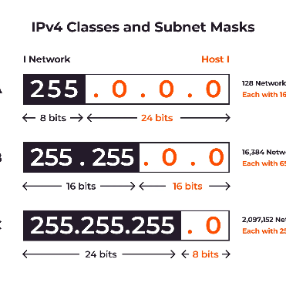
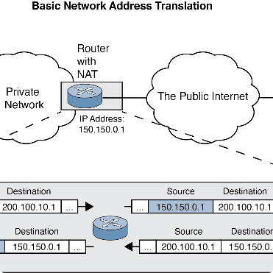
IPV4 Address Format
IPv4 Format
Subnet Mask
Public vs Private
IPV4 is a 32-bit address scheme. It uses four sets of numbers from 0-255, separated by dots. For example, 192.168.1.1 is a common IPV4 address.
The subnet mask determines the number of bits used for network vs host identification. For example, 255.255.255.0 indicates that the first 24 bits are used for network identification.
Public IP addresses are available for internet-facing devices, while private IP addresses are used for internal network communication. Private IP ranges include 192.168.x.x, 10.x.x.x, and 172.16.x.x-172.31.x.x.

Slide 3

IPV6 Address Format
IPv6 Format
Address Types
Benefits of IPV6
IPV6 uses a 128-bit address scheme. It consists of eight sets of characters separated by colons. For example, 2001:0DB8:AC10:FE01:: is a common IPV6 address.
IPV6 includes unicast, multicast, and anycast addresses. Unicast is used for individual devices, multicast for group communication, and anycast for the nearest device in a group.
IPV6 provides an almost unlimited amount of IP addresses, improved network performance, and enhanced security features compared to IPV4.

Slide 4

IPv4 Addressing Scheme
Class A: First octet defines network, rest define host (e.g. 10.0.0.1)
Class B: First two octets define network, rest define host (e.g. 172.16.0.1)
Class C: First three octets define network, rest define host (e.g. 192.168.0.1)
Class D: Used for multicasting
Class E: Reserved for future use
IPv6 Addressing Scheme
IPv6 addresses are divided into three parts: the prefix, the subnet ID, and the interface ID. The prefix is used to identify the network, the subnet ID is used to identify subnets within the network, and the interface ID is used to identify the device.

Slide 5

Reserved Ports
Well-known vs Registered
Well-known ports range from 0-1023 and are standardized for commonly used applications. Registered ports range from 1024-49151 and are for less commonly used applications.
1
2
3
Port Numbers
Dynamic Ports
Port numbers are used to keep track of application-specific data. They are used by the Transport Layer of the OSI model.
Dynamic ports range from 49152-65535 and are used for temporary connections and applications.

Slide 6


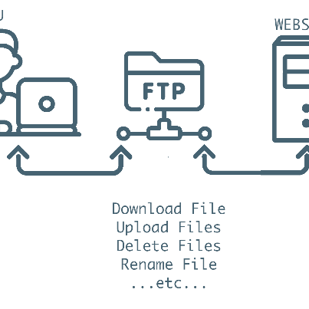
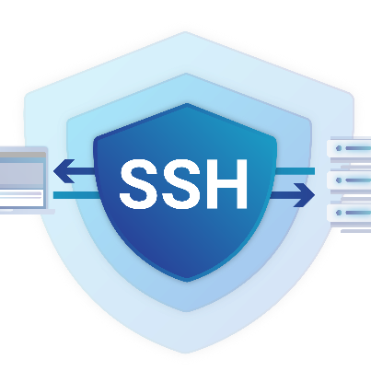
Applications Using Reserved Ports
Skype
FTP
SSH
Skype uses port 80 (HTTP) and port 443 (HTTPS) for communication.
FTP uses port 21 for control and port 20 for data transfer.
SSH uses port 22 for secure remote access.

Slide 7

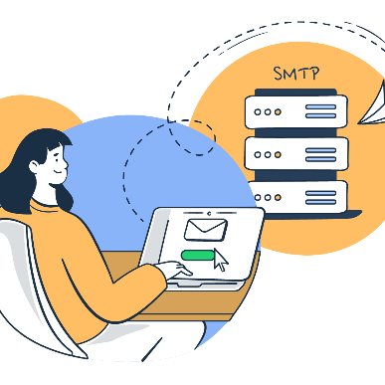
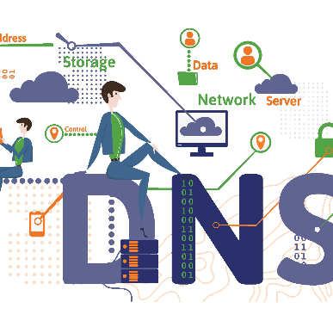

Applications Using Reserved Ports
SMTP
DNS
MySQL
SMTP uses port 25 for email transmission.
DNS uses port 53 for name resolution.
MySQL uses port 3306 for database management.

Slide 8

Conclusion
1
IPV4 and IPV6
2
Reserved Ports
3
The Future of IP Addressing
Both IPV4 and IPV6 have their place in modern computer networking.
Understanding reserved ports is essential to keeping applications running smoothly on a network.
As technology evolves, we may see new addressing schemes and protocols emerge to handle the ever-increasing demand for network connectivity.

